Slide 1
Perceived “Resource Dependence” and Canadian Public Universities
(My Attempt at) Building a Fine-Tuned Classifier via LLM Encoder
Sara Murphy, Computational Text Analysis, April 13, 2026

Slide 2
Overview
Goal:
Detect presence of perceived “resource dependence” language for public universities
Detect intensity of perceived “resource dependence” language – low vs high
Methods:
Built Fine Tuned Classifier LLM Encoder (0,1) – perceived resource dependence (no or yes)
Built Fine Tuned Classifier LLM Encoder (0,1) – intensity of perceived resource dependence (low or high)
Future Application:
Relationship between perceived resource dependence and financial performance (presence, intensity)
Predict financial performance in provinces outside Ontario (e.g. Nova Scotia)
Link perceived resource dependence to leadership background and frequency of change
Challenges/Limitations:
Sample size
Variation in documents across universities
Conceptual ambiguity and human validation
Moving to application stage

Slide 3
Context:
Public Universities in Ontario (Post 2019)

Slide 4

($63 million)
-9%
“Queen’s could cease to exist”
Notes:
Coppolino, S. (2024, January 9). “Queen’s could cease to exist if we don’t deal with this issue:” faculty and staff remain skeptical. The Queen’s Journal. https://www.queensjournal.ca/queens-university-faces-imminent-closure-if-cuts-not-made-faculty-and-staff-remain-skeptical/
`

Slide 5




1/2
(~$300M)
(~$600M)
Notes:
https://www.therecord.com/news/waterloo-region/university-of-waterloo-sees-75m-deficit-ahead-proposes-hiring-limit/article_25a1bf10-0f48-5489-9d56-0524fda12dd6.html
https://ontariosuniversities.ca/news/cou-statement-ontarios-universities-call-for-support-in-upcoming-fall-economic-statement/
Ontario Universities. Get to Know Ontario’s Universities – OUInfo. Ouinfo.ca. https://www.ouinfo.ca/universities
CTV News Toronto. (2024, February 26). Ontario freezes post-secondary tuition for 3 more years, adds $1.3B in funding [Review of Ontario freezes post-secondary tuition for 3 more years, adds $1.3B in funding]. CTV News Toronto; CTV News. https://toronto.ctvnews.ca/ontario-freezes-post-secondary-tuition-for-3-more-years-adds-1-3b-in-funding-1.6783368
U of T. Budget Report 2023-2024. Planning & Budget Office, 2023.
Western University: 2024-2025 Operating and Capital Budgets [Review of Western University: 2024-2025 Operating and Capital Budgets]. Western University. https://www.ipb.uwo.ca/documents/2024_budget.pdf
McMaster University. 2024-2025 Consolidated Budget. Board of Governors , 2024.

Slide 6



Slide 7


Construct:
Resource Dependence

Slide 8
Resource Dependence
Power & Resource Dependence, Emerson (1962)
“Power is the inverse of one’s dependency on the other in a relationship”
“Dependence = motivational investment in the same goals/rewards, inverse of availability of alternative means of achieving goals outside of the relationship”
Resource Dependence is not an objective concept
Yet typically studied in concrete terms (finances, resource flows)
There is a subjective, perceived or performative reality
No dictionaries or LLMs assess perceptions of RD via text analysis

Slide 9
Research Questions:
What a Fine-Tuned Classifier Could Help Answer

Slide 10
Research Questions
1) How does perceived resource dependence moderate the financial performance impact of the 2019 policy shock?
2) How does perceived resource dependence change in response to the 2019 policy shock ?
3) How does leadership succession cause change in perceived resource dependence pre and post the 2019 policy shock?

Slide 11
Data Collection, Processing & Sampling

Slide 12
Data: Original Plan
Operating Budgets
Ontario x 20 universities
British Columbia & Nova Scotia X 18 universities
2014-2025
Unit of Analysis
Introduction Section
“Setting the Context”, “Introduction”, “Executive Summary”, “Changing Financial Landscape”
1-5 pages of document
Paragraph Level
5 – 45 paragraphs per introduction section
No text pre-processing
Less than 288 tokens per paragraph
Size of Total Corpus
38 universities X 12 years X avg 12 paragraphs = 5,472 paragraphs
Notes:
Add descriptive statistics

Slide 13
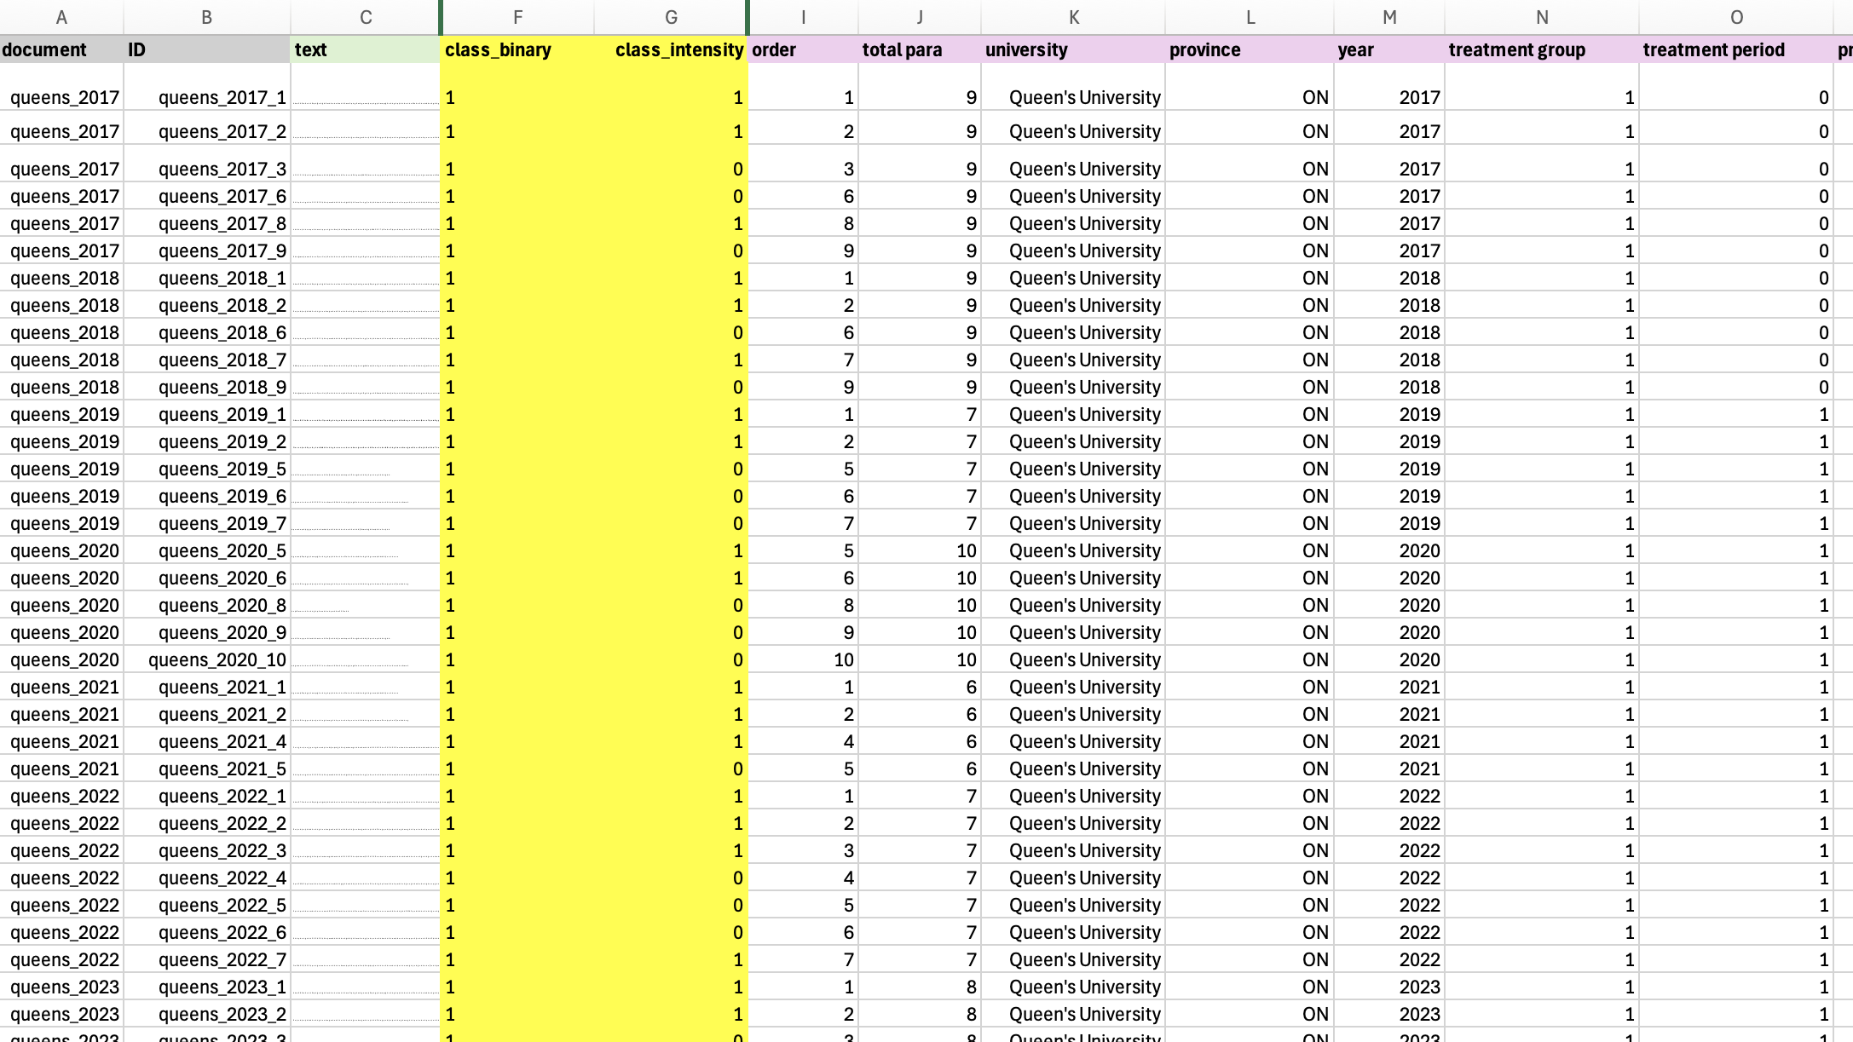
Building My Corpora

Slide 14
Variables & Codebook: Fine Tuner (1)
Class_Binary
0 = No Perceived Resource Dependence
1 = Perceived Resource Dependence
Label 0 = ANY paragraph that describes policy, funding, or risk WITHOUT evaluative language about constraint or opportunity
Key Words and Phrases:
References to the global economy , Covid-19 pandemic
References to budgeting process, descriptive budget information only
general references to policies or strategic mandate agreements without any adjectives or descriptive words implying dependence
Label 1 = ANY paragraph that clearly emphasizes at least one of:
alternative revenue source/generation/diversification
agency (“we will”, “we can”) framing of government policy
opportunity framing of government policy or funding
Challenge or constraint framing of government policy or funding

Slide 15
Variables & Codebook: Fine Tuner (2)
Class_Intensity
0 = Low Perceived Resource Dependence
1 = High Perceived Resource Dependence
Label 0 - Key word/phrase indicators (low perceived resource dependence)
Policy is a welcomed change
Need to diversify revenue
Alternative revenue generation
Providing some flexibility
Committed to balanced budgets
Flexibility in the form of a contingency fund
Push for advocacy
Label 1 = ANY paragraph that explicitly describes government policy or funding in terms of constraint, with no mention of agency or opportunity or alternative revenue sources
Key word/phrase indicators of Label 1 (high resource dependence language)
being in a vulnerable position
provincial grant revenue, although presenting with some certainty, is still financially limiting for the university
limited financial flexibility
the tuition framework continues to restrict flexibility for the university
restricted flexibility due to domestic tuition freeze
limited revenue growth opportunities

Slide 16

“provides predictability and stability”
Strategic Management Agreement (SMA)
“this is a welcomed change”
“at-risk funding”
“The differentiation policy framework re-confirms the university’s leadership role in research and innovation”
“the funding in the performance-based envelope will be at-risk assuming the targets in each metric are continually met”
“the university’s long-term advocacy for differentiation”
“the government decides the metrics, but the university sets the weights, and is measured against their own performance not other institutions”

Slide 17
Binary Classifier (Perceived RD)
Binary Classifier (Perceived RD Intensity)
Phase 1
Phase 2
Phase 3
Queen’s University
2017-2025
University of Toronto
2017-2025
Total observations:
327
Class 0 – No = 184
Class 1 – Yes = 143
Queen’s University
University of Toronto
Carleton University
University of Windsor
York University
Nipissing University
Lakehead University
Wilfrid Laurier University
University of Waterloo
Western University
McMaster University
Various Years
Post 2019
Total observations:
337
Class 0 – Low = 214
Class 1 – High = 123
Queen’s University
University of Toronto
Carleton University
University of Windsor
Various Years
Post 2019
Total observations:
236
Class 0 – Low = 154
Class 1 – High = 82
Add Sample
Phase 4
Total observations:
644
Class 0 – No = 307
Class 1 – Yes = 337
Revise Codes
Add Sample

Slide 18
Binary Classifier (Perceived RD)
Phase 1
V14. xlsx
RoBERTa, Google Colab
Stratified K Fold
No Class Weight Loss
No Weighted Sampling

Slide 19
Binary Classifier (Perceived RD)
Phase 1a
9 collapsed folds
 | fold | Train Loss | Val Loss | Accuracy | Weighted F1 | F1_0 | F1_1
0 | 1 | 0.698057 | 0.671035 | 0.560606 | 0.402766 | 0.000000 | 0.718447
1 | 1 | 0.664254 | 0.677310 | 0.560606 | 0.402766 | 0.000000 | 0.718447
2 | 1 | 0.568641 | 0.619747 | 0.636364 | 0.566919 | 0.333333 | 0.750000
3 | 1 | 0.505898 | 0.623363 | 0.681818 | 0.659631 | 0.533333 | 0.758621
4 | 2 | 0.689950 | 0.684404 | 0.560606 | 0.402766 | 0.000000 | 0.718447
5 | 2 | 0.681073 | 0.624862 | 0.590909 | 0.467437 | 0.129032 | 0.732673
6 | 2 | 0.547687 | 0.453209 | 0.757576 | 0.752681 | 0.692308 | 0.800000
7 | 2 | 0.396852 | 0.373532 | 0.772727 | 0.770956 | 0.727273 | 0.805195
8 | 3 | 0.685684 | 0.656347 | 0.569231 | 0.412971 | 0.000000 | 0.725490
9 | 3 | 0.671715 | 0.705432 | 0.569231 | 0.412971 | 0.000000 | 0.725490
10 | 3 | 0.621074 | 0.501803 | 0.738462 | 0.739704 | 0.721311 | 0.753623
11 | 3 | 0.491929 | 0.503208 | 0.784615 | 0.785641 | 0.766667 | 0.800000
12 | 4 | 0.705507 | 0.691357 | 0.569231 | 0.412971 | 0.000000 | 0.725490
13 | 4 | 0.679103 | 0.684476 | 0.569231 | 0.412971 | 0.000000 | 0.725490
14 | 4 | 0.585710 | 0.534585 | 0.707692 | 0.708254 | 0.666667 | 0.739726
15 | 4 | 0.438606 | 0.541963 | 0.707692 | 0.708662 | 0.698413 | 0.716418
16 | 5 | 0.702770 | 0.664352 | 0.553846 | 0.394821 | 0.000000 | 0.712871
17 | 5 | 0.666267 | 0.721653 | 0.553846 | 0.394821 | 0.000000 | 0.712871
18 | 5 | 0.614998 | 0.544134 | 0.584615 | 0.480802 | 0.181818 | 0.721649
19 | 5 | 0.532960 | 0.568837 | 0.692308 | 0.668401 | 0.545455 | 0.767442

Slide 20
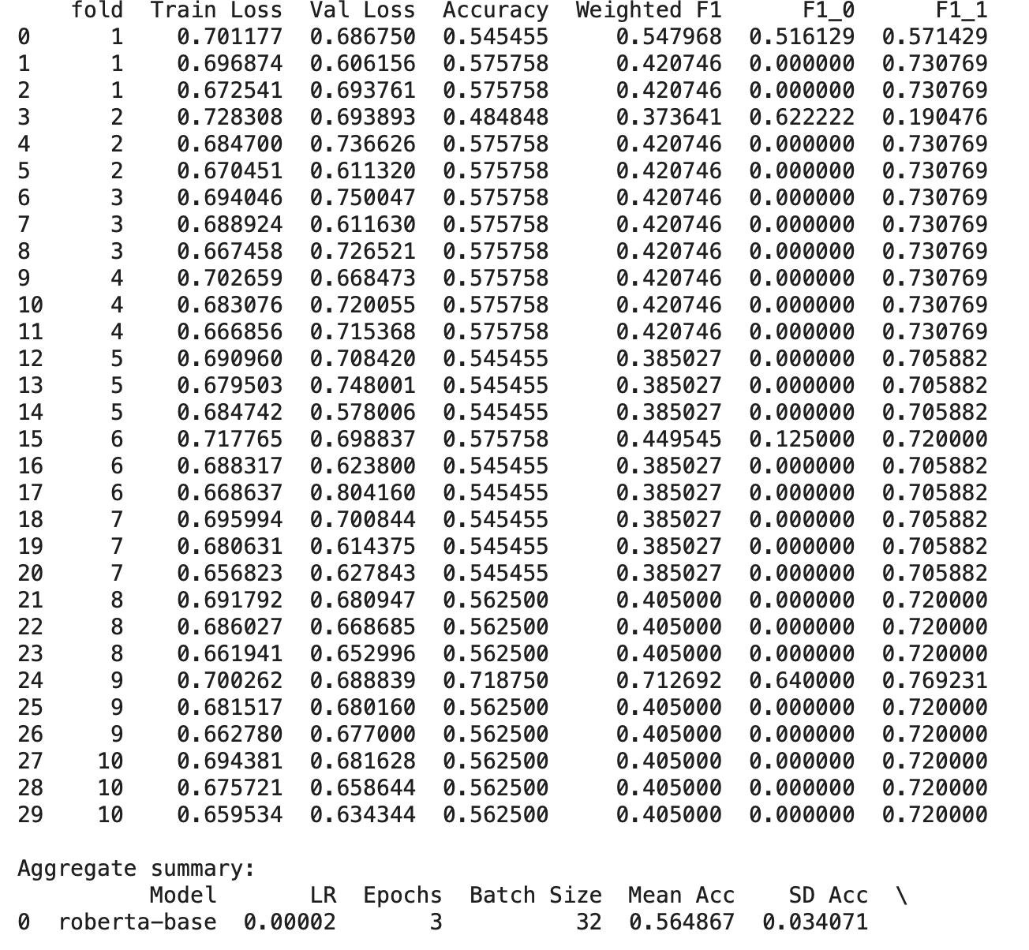
Binary Classifier (Perceived RD)
Phase 1b

Slide 21
Binary Classifier (Perceived RD Intensity)
Phase 2
V18. xlsx
Model performance varies substantially across folds, with F1 scores for dependence ranging from 0.00 to 0.84. This instability reflects the heterogeneity and contextual nature of dependence language, which is not uniformly distributed across training samples.
RoBERTA, Google Colab
Stratified K Fold
Class Weight Loss
No Weighted Sampling

Slide 22
Binary Classifier (Perceived RD Intensity)
Phase 2
6 collapsed folds
 | fold | Train Loss | Val Loss | Accuracy | Weighted F1 | F1_0 | F1_1
0 | 1 | 0.698116 | 0.692005 | 0.645833 | 0.506857 | 0.784810 | 0.000000
1 | 1 | 0.693579 | 0.680626 | 0.729167 | 0.734649 | 0.771930 | 0.666667
2 | 1 | 0.658137 | 0.648379 | 0.750000 | 0.734244 | 0.823529 | 0.571429
3 | 1 | 0.614589 | 0.611516 | 0.770833 | 0.769180 | 0.825397 | 0.666667
4 | 2 | 0.693276 | 0.690623 | 0.531915 | 0.498542 | 0.450000 | 0.592593
5 | 2 | 0.695861 | 0.685286 | 0.659574 | 0.524277 | 0.794872 | 0.000000
6 | 2 | 0.662835 | 0.669772 | 0.659574 | 0.524277 | 0.794872 | 0.000000
7 | 2 | 0.618959 | 0.655516 | 0.680851 | 0.571136 | 0.805195 | 0.117647
8 | 3 | 0.691353 | 0.686383 | 0.659574 | 0.657108 | 0.652174 | 0.666667
9 | 3 | 0.672812 | 0.658346 | 0.851064 | 0.854595 | 0.877193 | 0.810811
10 | 3 | 0.656609 | 0.562649 | 0.851064 | 0.854595 | 0.877193 | 0.810811
11 | 3 | 0.556855 | 0.457815 | 0.851064 | 0.854595 | 0.877193 | 0.810811
12 | 4 | 0.696751 | 0.688629 | 0.659574 | 0.524277 | 0.794872 | 0.000000
13 | 4 | 0.688263 | 0.676231 | 0.595745 | 0.589511 | 0.577778 | 0.612245
14 | 4 | 0.668917 | 0.638787 | 0.893617 | 0.892745 | 0.920635 | 0.838710
15 | 4 | 0.615458 | 0.585379 | 0.851064 | 0.846797 | 0.892308 | 0.758621
16 | 5 | 0.696382 | 0.689614 | 0.361702 | 0.192154 | 0.000000 | 0.531250
17 | 5 | 0.697424 | 0.685593 | 0.638298 | 0.497375 | 0.779221 | 0.000000
18 | 5 | 0.668353 | 0.655760 | 0.680851 | 0.586786 | 0.800000 | 0.210526
19 | 5 | 0.622997 | 0.626733 | 0.659574 | 0.572628 | 0.783784 | 0.200000

Slide 23
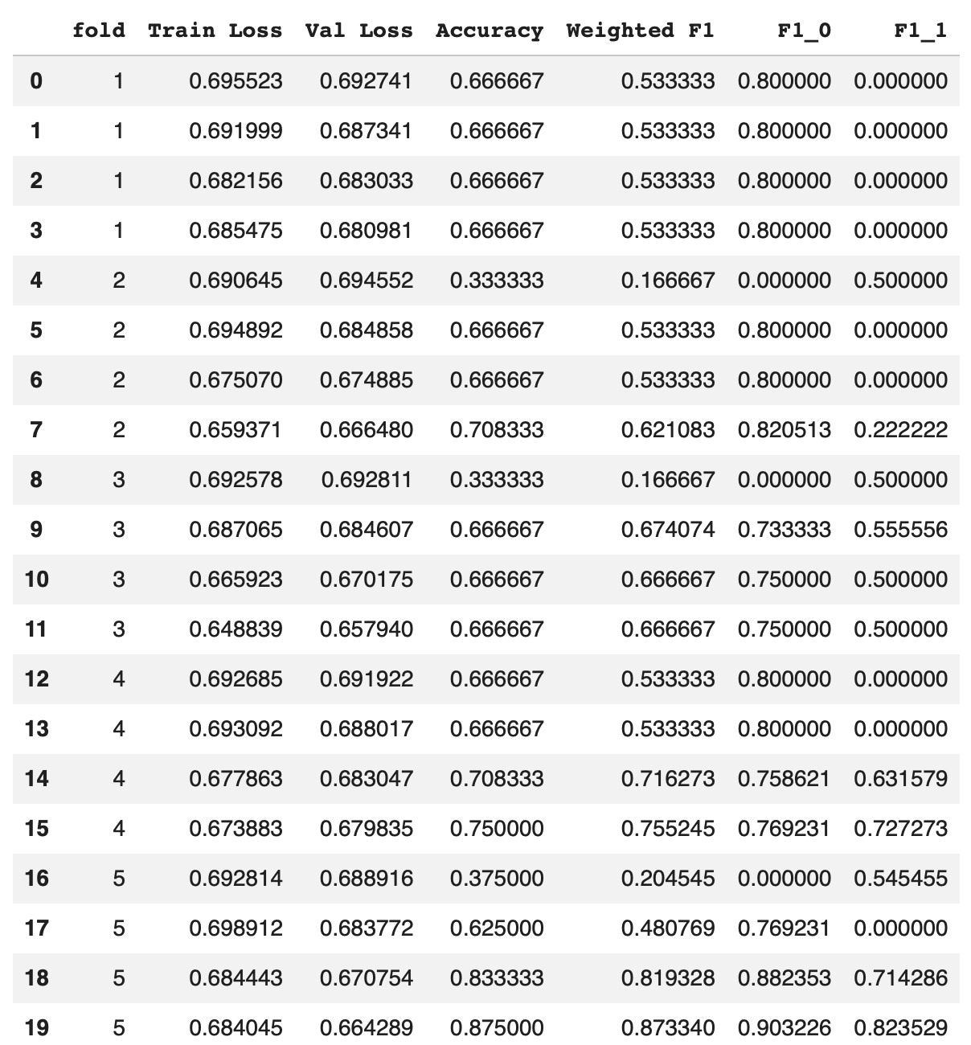
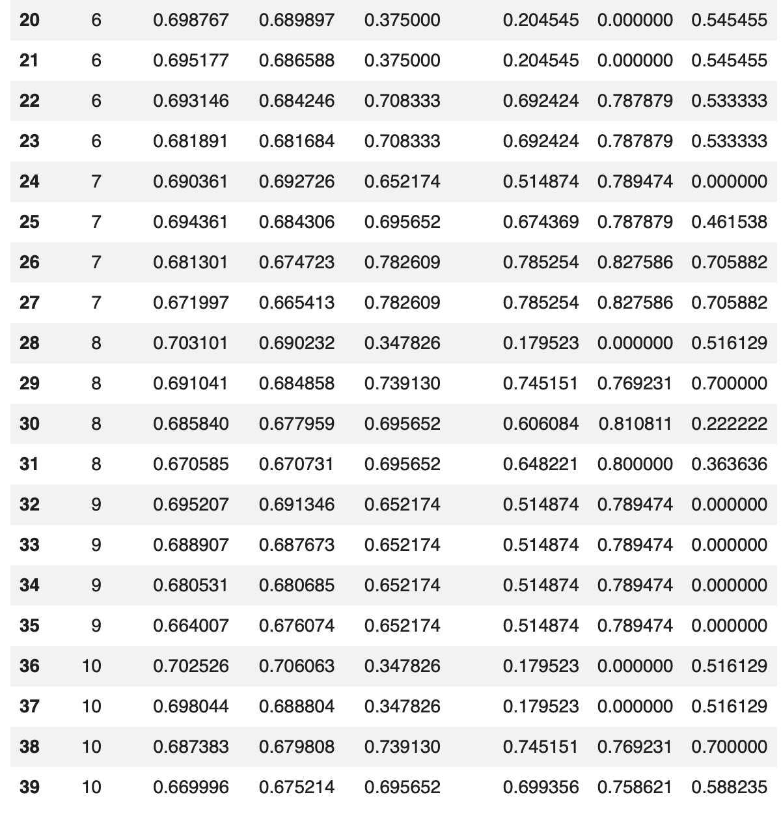
Binary Classifier (Perceived RD Intensity)
Phase 2b

Slide 24
Binary Classifier (Perceived RD Intensity)
Phase 3
V23. xlsx
Expanding the labeled dataset substantially improved model performance, enabling the classifier to reliably distinguish between low and high resource dependence. While early training epochs exhibited instability, later epochs produced consistent and balanced classification performance across folds, with F1 scores exceeding 0.70 for both classes.
RoBERTa, Google Colab
Stratified K Fold
No Class Weight Loss
Weighted Sampling

Slide 25
Binary Classifier (Perceived RD Intensity)
Phase 3
4 collapsed folds
 | fold | Train Loss | Val Loss | Accuracy | Weighted F1 | F1_0 | F1_1
0 | 1 | 0.696740 | 0.685739 | 0.632353 | 0.489931 | 0.774775 | 0.000000
1 | 1 | 0.677979 | 0.692894 | 0.367647 | 0.197660 | 0.000000 | 0.537634
2 | 1 | 0.627203 | 0.556448 | 0.735294 | 0.739938 | 0.763158 | 0.700000
3 | 1 | 0.419074 | 0.470369 | 0.735294 | 0.738642 | 0.780488 | 0.666667
4 | 2 | 0.694548 | 0.704199 | 0.367647 | 0.197660 | 0.000000 | 0.537634
5 | 2 | 0.684775 | 0.667640 | 0.705882 | 0.635590 | 0.811321 | 0.333333
6 | 2 | 0.684862 | 0.626919 | 0.779412 | 0.755143 | 0.848485 | 0.594595
7 | 2 | 0.608624 | 0.591515 | 0.808824 | 0.810779 | 0.843373 | 0.754717
8 | 3 | 0.697393 | 0.700866 | 0.373134 | 0.220217 | 0.045455 | 0.533333
9 | 3 | 0.685998 | 0.675704 | 0.701493 | 0.703909 | 0.761905 | 0.600000
10 | 3 | 0.574339 | 0.598587 | 0.835821 | 0.830786 | 0.879121 | 0.744186
11 | 3 | 0.425907 | 0.600454 | 0.761194 | 0.763127 | 0.809524 | 0.680000
12 | 4 | 0.696004 | 0.693863 | 0.417910 | 0.306874 | 0.170213 | 0.551724
13 | 4 | 0.673409 | 0.624674 | 0.701493 | 0.660931 | 0.800000 | 0.411765
14 | 4 | 0.589471 | 0.443287 | 0.776119 | 0.775024 | 0.827586 | 0.680851
15 | 4 | 0.411673 | 0.394154 | 0.820896 | 0.816735 | 0.866667 | 0.727273
16 | 5 | 0.705958 | 0.705578 | 0.373134 | 0.202790 | 0.000000 | 0.543478
17 | 5 | 0.702980 | 0.683265 | 0.582090 | 0.580413 | 0.575758 | 0.588235
18 | 5 | 0.640220 | 0.578193 | 0.641791 | 0.556831 | 0.769231 | 0.200000
19 | 5 | 0.558276 | 0.522041 | 0.776119 | 0.776966 | 0.819277 | 0.705882

Slide 26
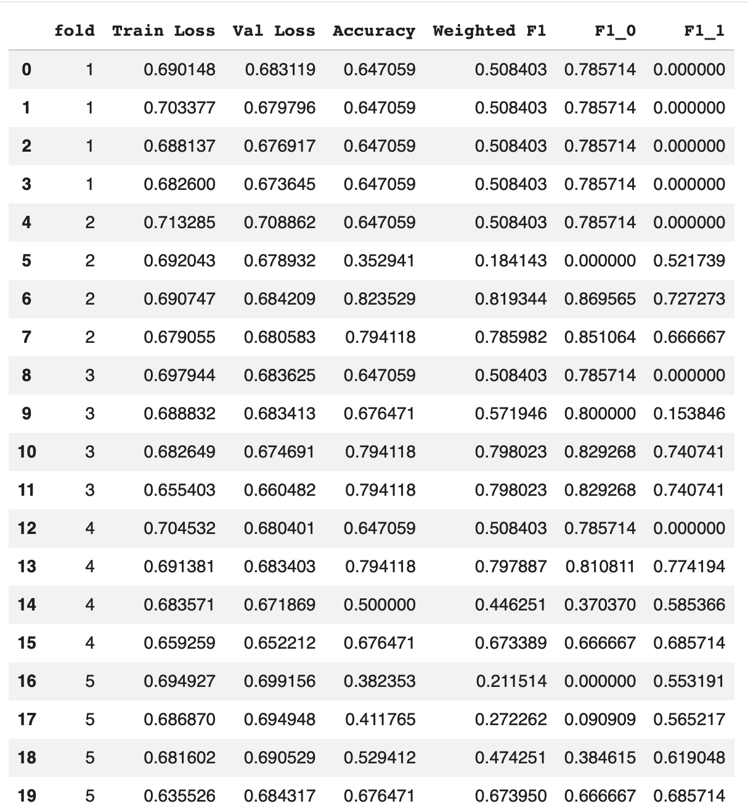
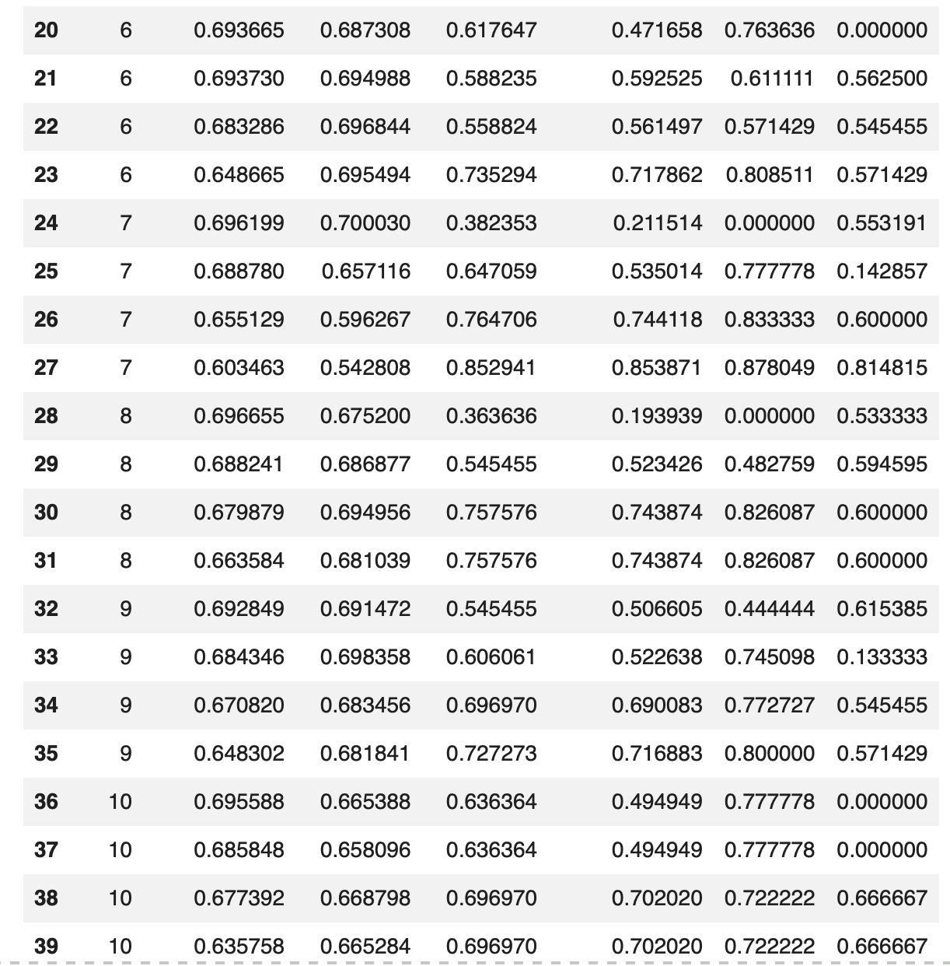
Binary Classifier (Perceived RD Intensity)
Phase 3b

Slide 27
Binary Classifier (Perceived RD)
Phase 4
V24. xlsx
Model is learning the task better, but occasionally fails depending on split.
RoBERTA, Google Colab
Stratified K Fold
No Class Weight Loss
No Weighted Sampling

Slide 28

Binary Classifier (Perceived RD)
Phase 4
2 collapsed folds
0 | 1 | 0.696145 | 0.662679 | 0.589147 | 0.509940 | 0.293333 | 0.710383
1 | 1 | 0.551947 | 0.472867 | 0.775194 | 0.769990 | 0.728972 | 0.807947
2 | 1 | 0.355285 | 0.553457 | 0.759690 | 0.759170 | 0.766917 | 0.752000
3 | 1 | 0.256874 | 0.463797 | 0.775194 | 0.775275 | 0.771654 | 0.778626
4 | 2 | 0.703262 | 0.666954 | 0.565891 | 0.451115 | 0.176471 | 0.705263
5 | 2 | 0.570475 | 0.434226 | 0.759690 | 0.750855 | 0.794702 | 0.710280
6 | 2 | 0.377443 | 0.323736 | 0.844961 | 0.844830 | 0.836066 | 0.852941
7 | 2 | 0.253668 | 0.313738 | 0.868217 | 0.868249 | 0.864000 | 0.872180
8 | 3 | 0.694697 | 0.678623 | 0.720930 | 0.717022 | 0.672727 | 0.756757
9 | 3 | 0.600294 | 0.444708 | 0.759690 | 0.754293 | 0.786207 | 0.725664
10 | 3 | 0.356214 | 0.414668 | 0.798450 | 0.796697 | 0.811594 | 0.783333
11 | 3 | 0.266678 | 0.397777 | 0.837209 | 0.837307 | 0.834646 | 0.839695
12 | 4 | 0.692051 | 0.690414 | 0.527132 | 0.363908 | 0.000000 | 0.690355
13 | 4 | 0.635584 | 0.602428 | 0.689922 | 0.681210 | 0.615385 | 0.740260
14 | 4 | 0.440954 | 0.460554 | 0.736434 | 0.730414 | 0.679245 | 0.776316
15 | 4 | 0.323973 | 0.726796 | 0.782946 | 0.781359 | 0.754386 | 0.805556
16 | 5 | 0.691395 | 0.675635 | 0.523438 | 0.359696 | 0.000000 | 0.687179
17 | 5 | 0.630537 | 0.518214 | 0.734375 | 0.729722 | 0.685185 | 0.770270
18 | 5 | 0.428796 | 0.444749 | 0.789062 | 0.787879 | 0.765217 | 0.808511
19 | 5 | 0.289322 | 0.429366 | 0.835938 | 0.835988 | 0.829268 | 0.842105

Slide 29
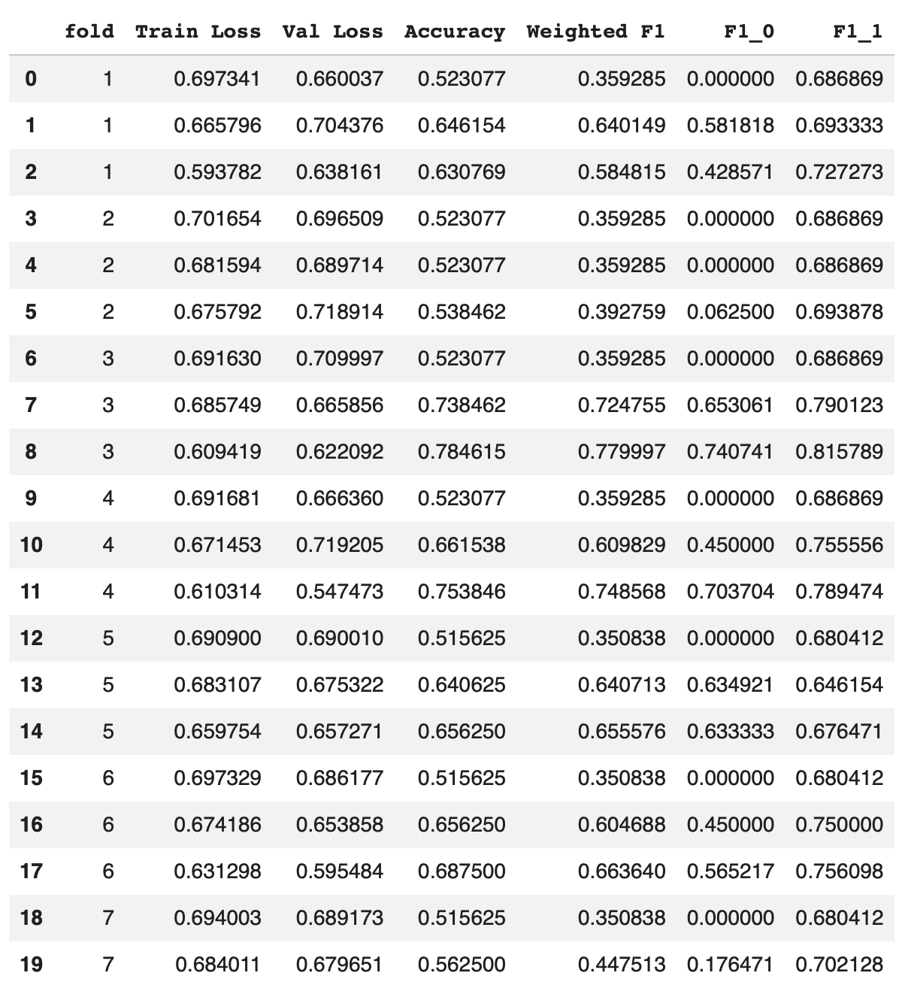
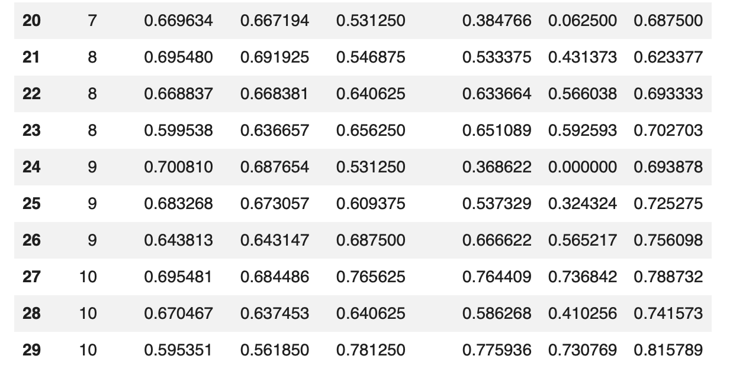
Binary Classifier (Perceived RD)
Phase 4b

Slide 30
Binary Classifier (Perceived RD)
Binary Classifier (Perceived RD Intensity)
Phase 1
Phase 2
Phase 3
Mean ACC | SD ACC | Mean Weighted FI
0.688 | 0.077 | 0.653
Mean ACC | SD ACC | Mean Weighted FI
0.759 | 0.073 | 0.726
Mean ACC | SD ACC | Mean Weighted FI
0.795 | 0.0390 | 0.7948
Phase 4
Best Optimal Epoch within Each Fold
Epoch = 4, Fold = 5, Batch = 16
Mean ACC | SD ACC | Mean Weighted FI
0.735 | 0.113 | 0.718

Slide 31
Binary Classifier (Perceived RD)
Binary Classifier (Perceived RD Intensity)
Phase 1
Phase 2
Phase 3
Mean ACC | SD ACC | Mean Weighted FI
0.5621 | 0.0126 | 0.4053
Mean ACC | SD ACC | Mean Weighted FI
0.7392 | 0.0766 | 0.7103
Mean ACC | SD ACC | Mean Weighted FI
0.7410 | 0.0705 | 0.7205
Phase 4
Best Optimal Epoch within Each Fold
Epoch = 3 or 4, Fold = 10, Batch = 32
Mean ACC | SD ACC | Mean Weighted FI
0.656 | 0.106 | 0.603

Slide 32
Challenges & Adjustments
Issues:
Folds collapsing to one category (Low Mean Weighted F1, Mean F1, Mean F0)
Sample Size
Weak Signal
Time consuming to build Class 1 (High PRD)
Re-classifying codes regularly in earlier stages
Sentence level versus paragraph level as unit of analysis
Changes:
Class Weighted Loss
Weighted Sampling within Folds
Stratified K Fold
Epoch = 4
Learning Rate

Slide 33
Future Applications and Next Steps
Analyze changes in perceived resource dependence (pre/post 2019)
Link to financial performance (t +1)
Link to leadership succession (background and frequency of change)
Predict on universities outside of Ontario (i.e Nova Scotia)

Slide 34
Main Takeaways
Validate!
A computer can’t do what humans can’t do
Need a strong signal between classes within text
Need sufficient sample size in each class

